Slide 1
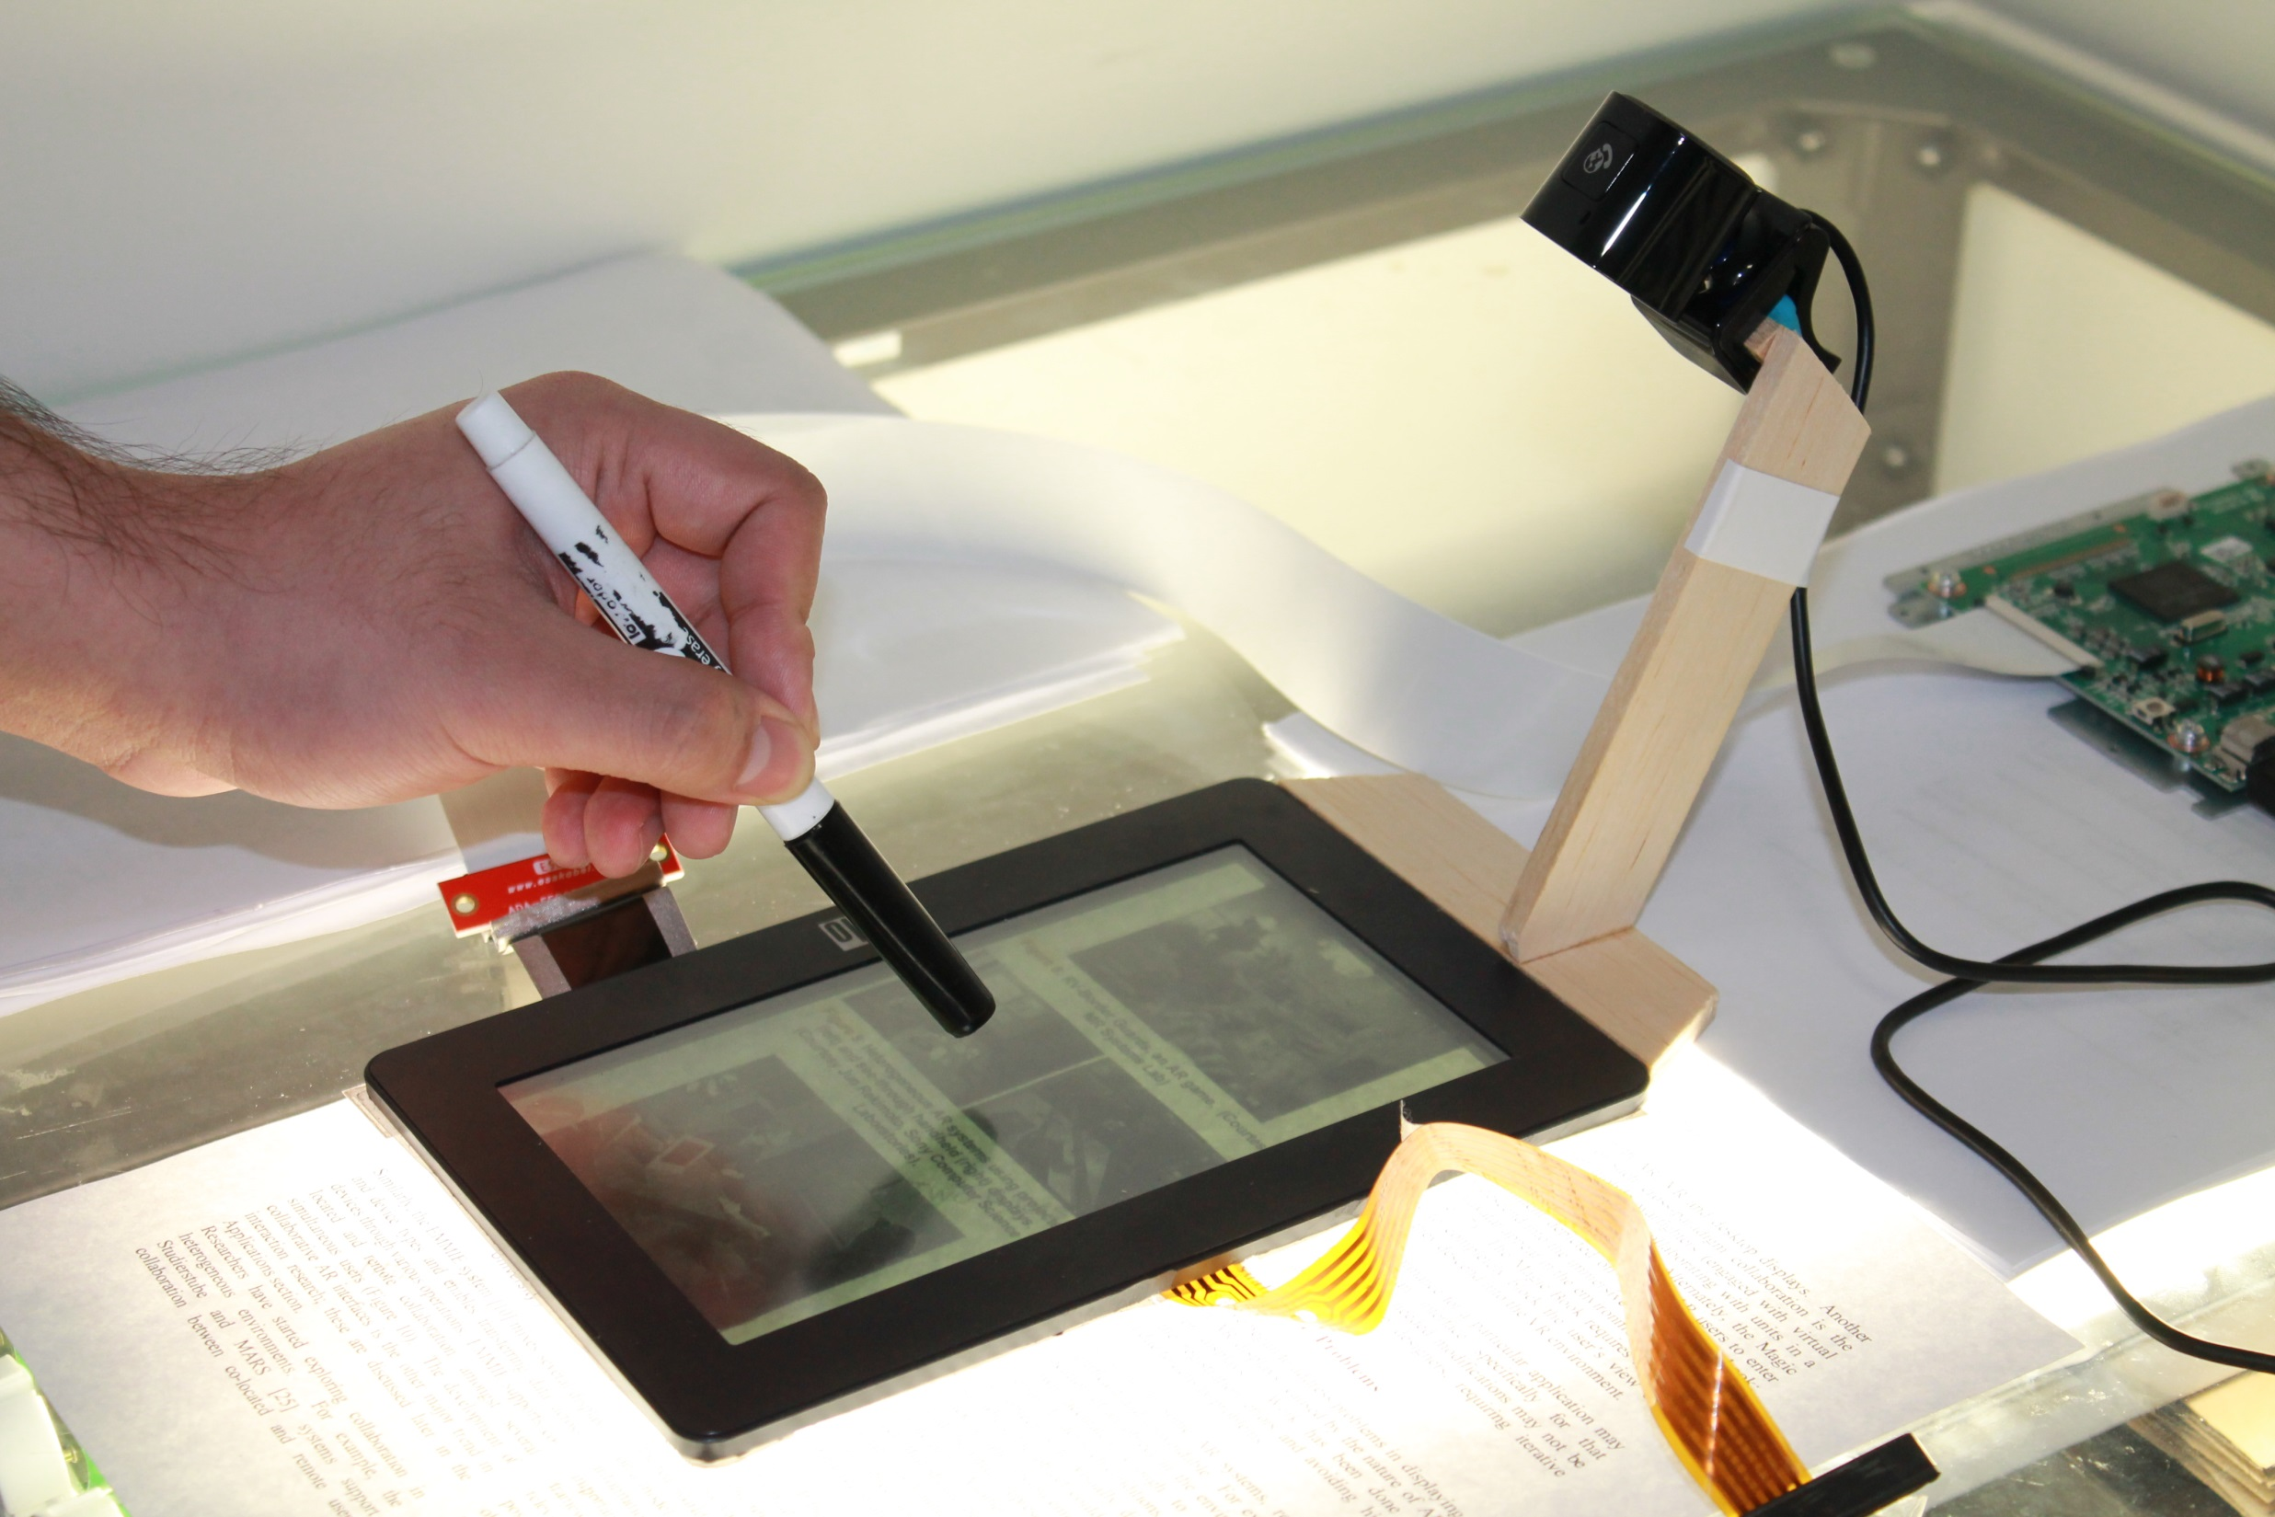
Contact Augmented Reality & tPad

Slide 2

Juan David Hincapié-Ramos, Sophie Roscher Wolfgang Buschel, Ulrike Kister, Ridmund Daschel, Pourang Irani

Slide 3
present contact-augmented reality
usage in active reading
reviews
feedback -
research directions -

Slide 4
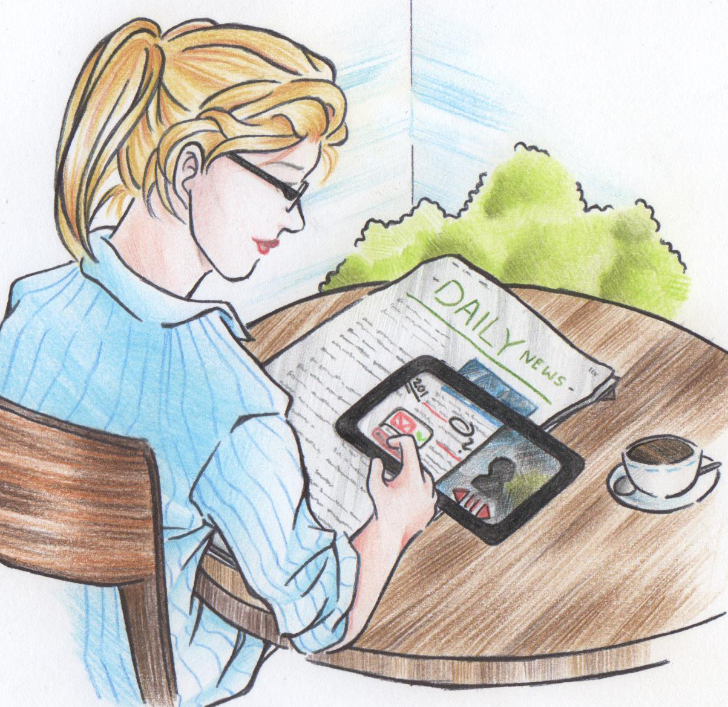

Slide 5
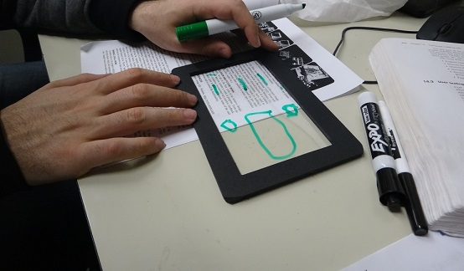

Slide 6
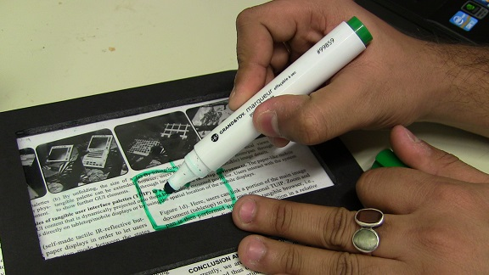

Slide 7


Slide 8
Active Reading
- combination of reading, critical thinking, and learning
- read to gain knowledge and understand all aspects of a specific topic
reading
outlining
underlining
highlighting
searching
scribbling
digital annotations
note-taking
non-sequential navigation
information seeking
quoting
comparing
content sharing

Slide 10
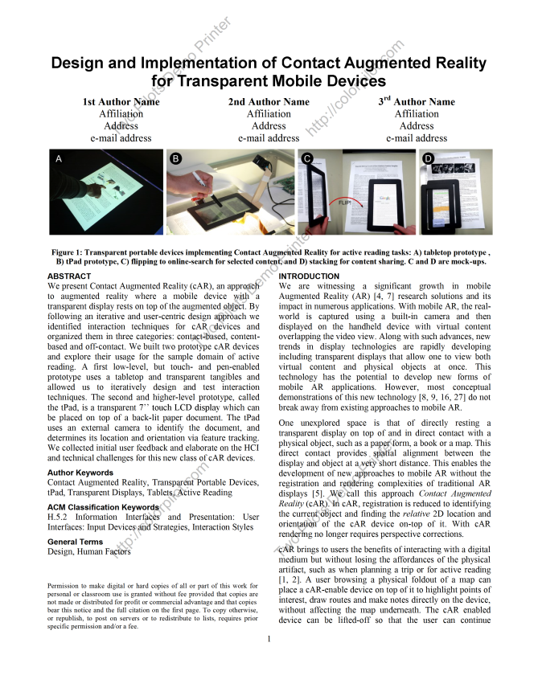
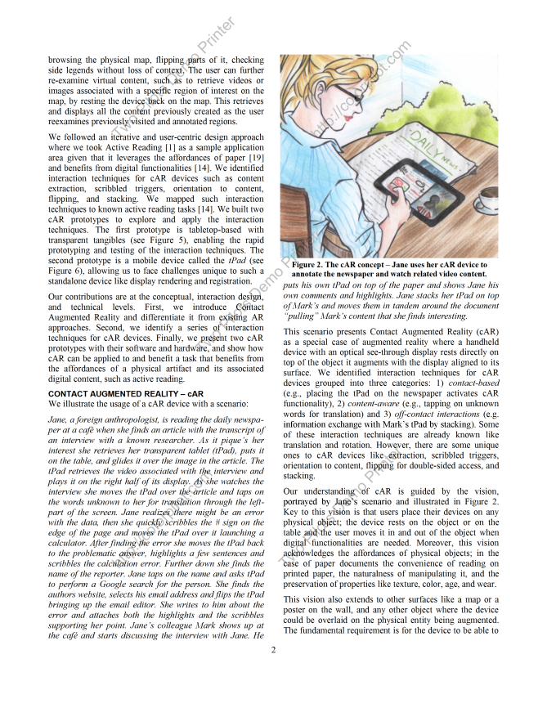
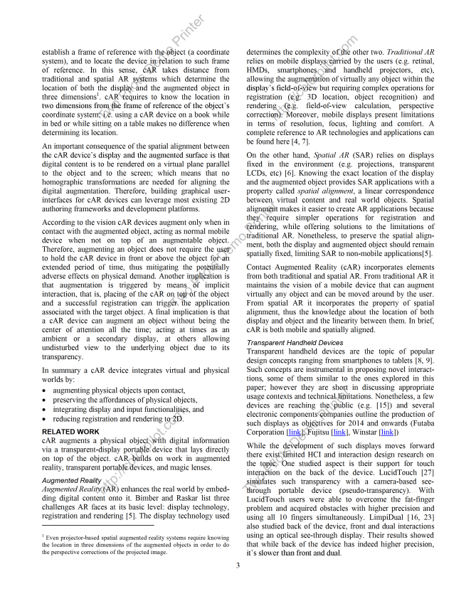
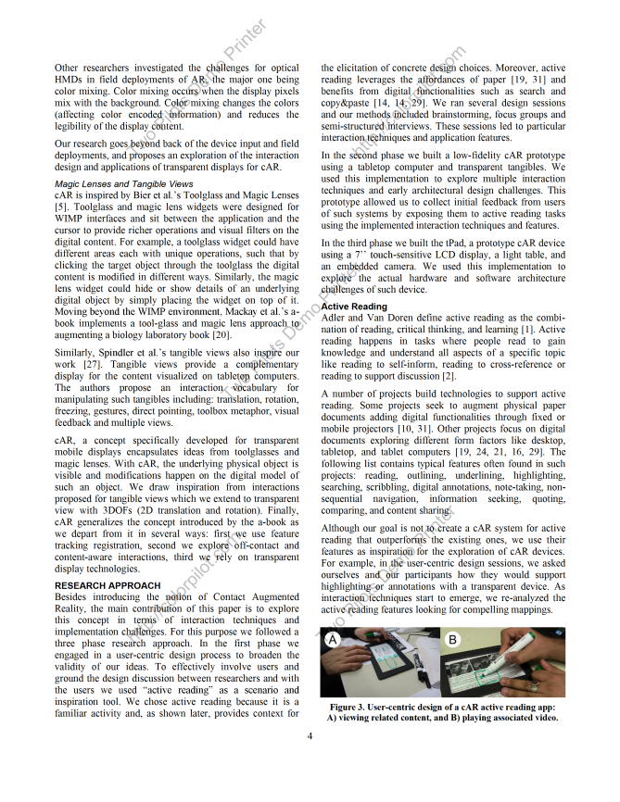
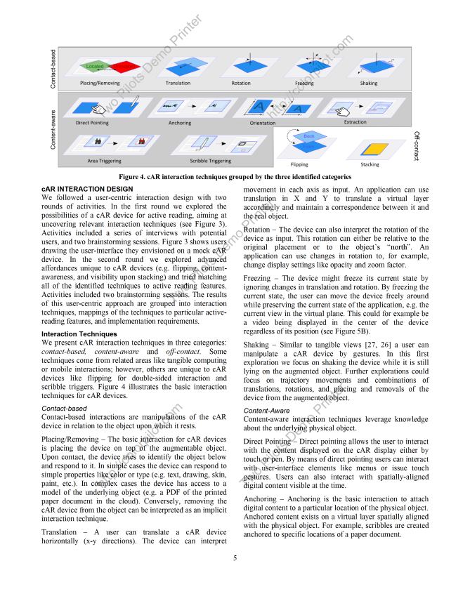
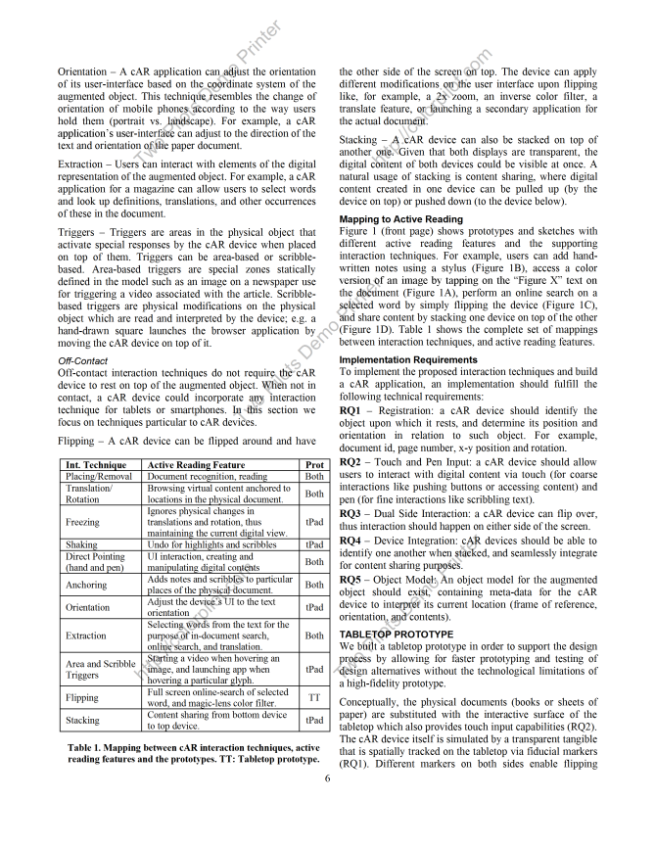
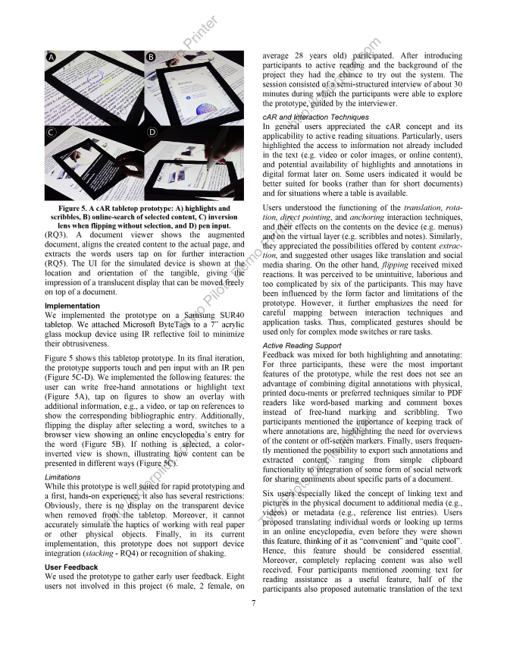
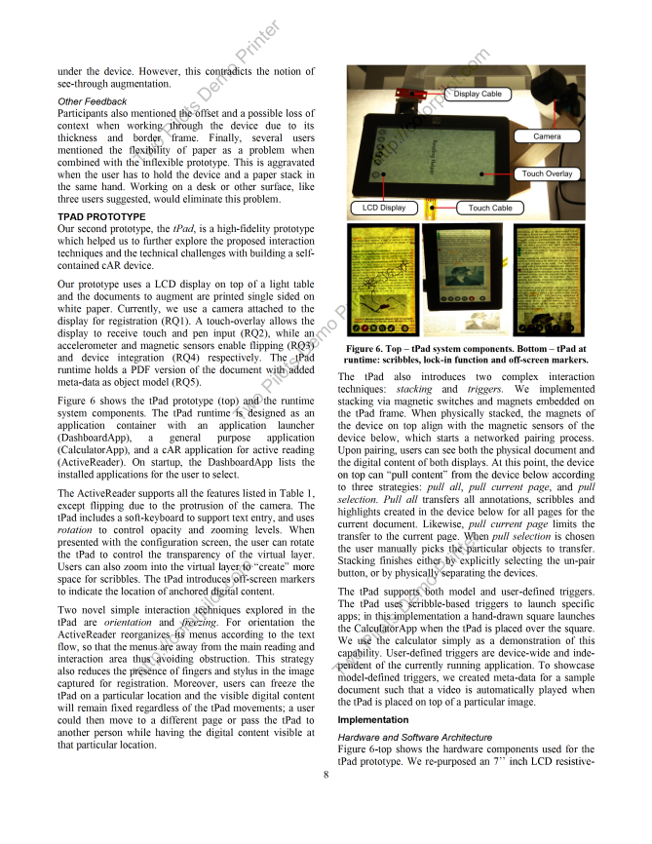
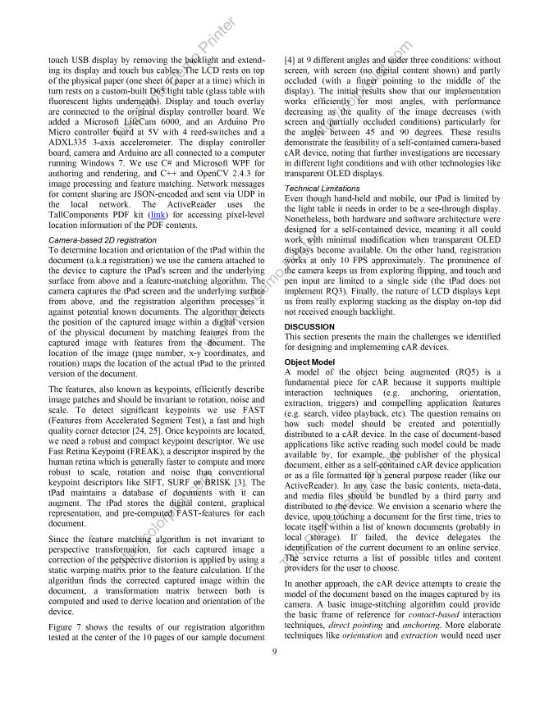
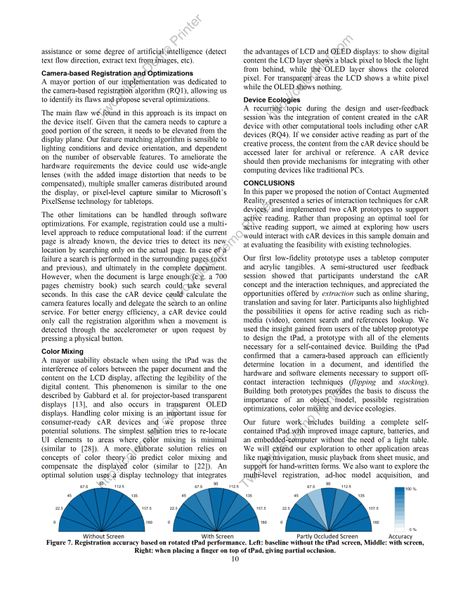
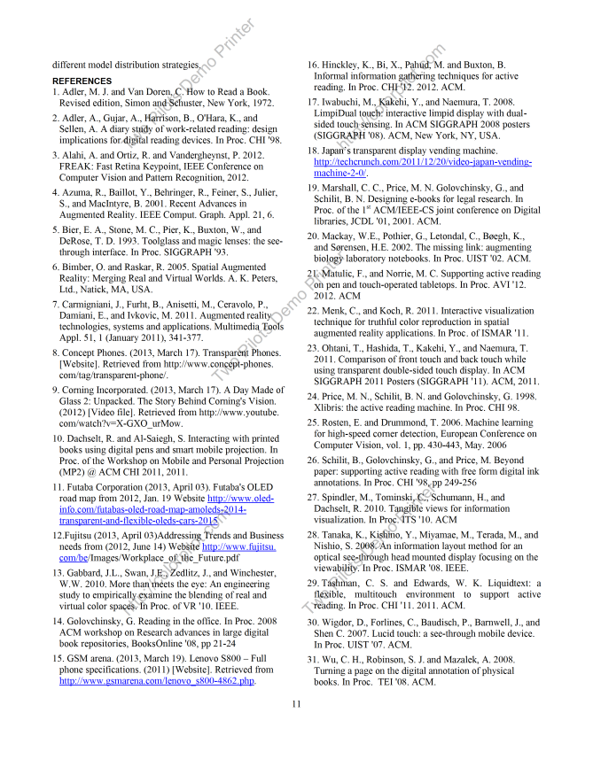

Slide 11
While conceptually interesting, the quality of actual prototype is not appealing. Some part is just a simulation using large display with a mockup display frame as a "prop" of transparent computer. A prototype device with transparent LCD is more interesting, but it is still not clear how this device recognize the position and content of the document.
In addition, interaction ideas itself are not quite novel. Many are already proposed using a combination of real paper document and projection. Although this "transparent display" approach may have more potential (in terms of scalability and mobility), the proposed prototype still requires external cameras, and thus (at this moment), is not compelling enough.
More fundamental question is, "do we really need this combination?" or "do we still use paper document when transparent computers will become commonplace in the future?". In near future, when transparent computer will become available, it is not unrealistic to expect normal tablet computers will also become very advanced and commonplace (than what we can use now). In such a future, it is not convincing to think there is a large necessity to add annotation to printed document, because people may do every paperwork on their (far advanced) table computers.

Slide 12
3
While conceptually interesting, the quality of actual prototype is not appealing. Some part is just a simulation using large display with a mockup display frame as a "prop" of transparent computer. A prototype device with transparent LCD is more interesting, but it is still not clear how this device recognize the position and content of the document.
In addition, interaction ideas itself are not quite novel. Many are already proposed using a combination of real paper document and projection. Although this "transparent display" approach may have more potential (in terms of scalability and mobility), the proposed prototype still requires external cameras, and thus (at this moment), is not compelling enough.
More fundamental question is, "do we really need this combination?" or "do we still use paper document when transparent computers will become commonplace in the future?". In near future, when transparent computer will become available, it is not unrealistic to expect normal tablet computers will also become very advanced and commonplace (than what we can use now). In such a future, it is not convincing to think there is a large necessity to add annotation to printed document, because people may do every paperwork on their (far advanced) table computers.

Slide 13
Also, I believe the submission would benefit of some sort of comparison discussion that includes today's existing alternatives (i.e., standard augmented reality that we all have accustomed to) for the application opportunities the authors are suggesting. Specifically, what can cAR bring over standard AR or standard pen/touch mobile devices for the application cases presented in the paper.

Slide 14
3
Also, I believe the submission would benefit of some sort of comparison discussion that includes today's existing alternatives (i.e., standard augmented reality that we all have accustomed to) for the application opportunities the authors are suggesting. Specifically, what can cAR bring over standard AR or standard pen/touch mobile devices for the application cases presented in the paper.

Slide 15
Overall, what upsets me about this work is that the authors leave the two hardest questions unanswered and without any discussion: 1) what is the benefit of transparency here compared to the spatially registered mobile display, and 2) how could one actually implement this idea in practice (i.e., without a camera sticking out of the screen)? Let me elaborate... … This paper should have a serious discussion and possibly a comparison to such an alternate implementation to clearly present to the reader the value of purely transparent device in this context. Second, there is very little discussion on how such devices could be implemented in practice. Having a camera on the pole observing the transparent overlay is definitely fine for prototyping, but some ideas would be welcome on what possibilities exist to make this a reality… These two issues make me unable to argue for acceptance of this paper. While there is definitely some novelty here, I believe that the authors deliberately avoided the most interesting and important questions in making this a fully functioning concept. Overall, I am not super enthusiastic about this work, but it clearly has some merits which is why I have given it a score of 3.

Slide 16
3
Overall, what upsets me about this work is that the authors leave the two hardest questions unanswered and without any discussion: 1) what is the benefit of transparency here compared to the spatially registered mobile display, and 2) how could one actually implement this idea in practice (i.e., without a camera sticking out of the screen)? Let me elaborate... … This paper should have a serious discussion and possibly a comparison to such an alternate implementation to clearly present to the reader the value of purely transparent device in this context. Second, there is very little discussion on how such devices could be implemented in practice. Having a camera on the pole observing the transparent overlay is definitely fine for prototyping, but some ideas would be welcome on what possibilities exist to make this a reality… These two issues make me unable to argue for acceptance of this paper. While there is definitely some novelty here, I believe that the authors deliberately avoided the most interesting and important questions in making this a fully functioning concept. Overall, I am not super enthusiastic about this work, but it clearly has some merits which is why I have given it a score of 3.

Slide 17
This work is situated at the intersection of three main areas: magic lenses type interaction techniques, tangible widgets on tabletops, and active reading as an application domain. Given this space, I think the authors need to do a better job positioning this work with respect to previous research. While this paper tells an augmented reality story and envisions a general purpose device that can presumably be used in a wide variety of context, the interaction techniques, first prototype and user feedback seem very much related to magic lenses and tabletops. Given the work in these two domains, the interaction techniques unfortunately do not seem overly novel nor like a significant contribution. The authors need to clearly articulate why these interactions are novel. It is also not clear what value the tPad prototype has for this paper. In particular, what was learned in building and discussing this device (beyond showing the fact that transparent display are becoming a reality which I think this community knows). Furthermore, there are several technical challenges with such a device, but the authors do not seem to advance the state of the art (eg registration, issues with color mixing, etc). Together, this seems like a promising area of investigation, but this work is either too preliminary or needs to be better presented to differentiate the interaction techniques as implemented and studied.

Slide 18
2
This work is situated at the intersection of three main areas: magic lenses type interaction techniques, tangible widgets on tabletops, and active reading as an application domain. Given this space, I think the authors need to do a better job positioning this work with respect to previous research. While this paper tells an augmented reality story and envisions a general purpose device that can presumably be used in a wide variety of context, the interaction techniques, first prototype and user feedback seem very much related to magic lenses and tabletops. Given the work in these two domains, the interaction techniques unfortunately do not seem overly novel nor like a significant contribution. The authors need to clearly articulate why these interactions are novel. It is also not clear what value the tPad prototype has for this paper. In particular, what was learned in building and discussing this device (beyond showing the fact that transparent display are becoming a reality which I think this community knows). Furthermore, there are several technical challenges with such a device, but the authors do not seem to advance the state of the art (eg registration, issues with color mixing, etc). Together, this seems like a promising area of investigation, but this work is either too preliminary or needs to be better presented to differentiate the interaction techniques as implemented and studied.

Slide 19
Portions of it seem very similar to the Embodied Lens work by Kim and Elmqvist [citation below] - the tabletop prototype used in the cAR paper is also very similar to the embodied lens prototype in the use of a transparent frame on a tabletop tracked by a fiducial marker. Techniques described such as placement, removal, translation, rotation, as well as direct pointing are discussed in the Embodied Lens work. Augmented Maps work by Reitmayr et al. [citation below] also has some similar qualities of content-aware interaction. The authors should reference these two works. Having said that, there does seem to be some uniqueness to the tPad implementation. I would like to have seen the authors spend more time on that implementation and delve more into some of the more novel aspects of cAR that one might not find in an existing AR system - e.g. scribble triggering, contact, semantic/content recognition and prop-based manipulation. Direct pointing and Anchoring are pretty standard in traditional AR. So what's truly unique about an AR display that is in direct planar contact with the physical world being augmented?

Slide 20
3
Portions of it seem very similar to the Embodied Lens work by Kim and Elmqvist [citation below] - the tabletop prototype used in the cAR paper is also very similar to the embodied lens prototype in the use of a transparent frame on a tabletop tracked by a fiducial marker. Techniques described such as placement, removal, translation, rotation, as well as direct pointing are discussed in the Embodied Lens work. Augmented Maps work by Reitmayr et al. [citation below] also has some similar qualities of content-aware interaction. The authors should reference these two works. Having said that, there does seem to be some uniqueness to the tPad implementation. I would like to have seen the authors spend more time on that implementation and delve more into some of the more novel aspects of cAR that one might not find in an existing AR system - e.g. scribble triggering, contact, semantic/content recognition and prop-based manipulation. Direct pointing and Anchoring are pretty standard in traditional AR. So what's truly unique about an AR display that is in direct planar contact with the physical world being augmented?

Slide 21
motivation (paper? really?)
better comparison to AR
benefit of the transparency
interaction techniques not that novel
quality of the tPad prototype
technical challenges of the implementation

Slide 22
and now?

